Slide 1
THE SAGA
of
THE LIVELY
Once Upon a Time.. In a school district not far away, the South Kitsap School
Board decided it was a good idea to buy a surveyed (meaning at auction) 44 foot luxury racing sloop named the Lively. They were proud and boasted that SKSD owns the biggest sailboard of any public school district in Washington State. This was in 2015.
One day many years later, a board director who regularly reviewed bills and warrants and found monthly bill paid by the district for "moorage" fees for something called "Lively". The cost was around $190 a month. He asked what the "Lively" was and discovered it is a boat 44’ sailboat for used by NJROTC. Still not understanding, the director asked where the boat was. He was told it was moored in slip 71 at the PO Marina. Access is restricted so he asked for a "tour" of the boat. They agreed. He toured it on a Friday accompanied by the District Superintendent since he also had never seen it.

Slide 2
Lively Saga Cont.
THE SCHOOL BOARD DIRECTOR had been reviewing the warrants (Bills) and found monthly bills paid by the District for “MOORAGE" fees for something called The "Lively". Moorage fees are more than $190/mo now. He asked what the Lively was used for. They told him it is a 44’ sailboat used by NJROTC. Still not fully understanding, the Director asked where the boat was moored and was told it was
at slip #71 at the Port Orchard Marina. Access is restricted, so he had to ask for “PERMISSION” (even though a Board Member) to visit the Lively. He asked for a tour. The District granted his request and he visited the Lively on a Friday.
Interestingly enough, the SKSD Superintendent came along as he had never seen the boat and stated he was not aware the District owned a sailboat. Imagine that, a bill being paid he did not know about This is what happens when all District bills are paid by “Unanimous Consent” at board meetings where bills are never discussed or checked.
At the marina the NJROTC Boat Captain took them aboard the boat. The Lively sleeps nine, is diesel powered with two sails on a 65 foot mast. They said they try to take cadets out once a week if the weather is good. They also like to visit Blake Island for overnight camping. The stated purpose of the Lively is instill team work. Of course it is also a great recruitment tool for NJROTC. It was auctioned off by the U.S. Naval Academy with SKSD paying $8,000 for it in 2015.

Slide 3
Lively Saga Cont.
The Board Member asked what the cost of this boat was given the rigging, sails, motor, paint, etc. They said they had no idea but say most of it is donated or at cost since several community members "support" the boat as boating instructors, etc. It must be hauled out the water regularly for hull maintenance. Port Orchard has no equipment large enough to do this so the Lively must sailed to a distant location to do this.It costs the District about $5K (reduced price) to take the Lively out of the water. They call this Dry-Docking. Any other work costs are in addition to the docking costs. The Board Member then asked how many ‘OTHER’ SKSD Kids get to use the Lively besides the NJROTC Cadets. The answer was “NO OTHERS” since SKSD has no sailing club, So, the Lively Is expensive toy
used by a privileged few to teach teamwork and recruit more NJROTC Student Cadets. There are currently about 40 Cadets. Of the approximate 9,975 students attending SKSD Schools, 40 NJROTC cadets notably only represents 0.4% of SKSD entire student population. Please tell us how this is an ‘inclusive’ use of the Lively.
The board member and Superintendent said thanks for the tour and then left. AND the Board Member and the District Superintendent were not very happy as they each drove away.. But this is far from the end of this story.

Slide 4
Short Video of Lively Underway
Kitsap Sun Short Video Clip SKSD 41' Lively Underway.
https://drive.google.com/file/d/1Dj2ykKSVxzY6qh0lsp9UsNv8-Q4vZaAb/view?usp=sharing
Please Turn on Your Sound
SKSD STILL OWNS THE BIGGEST (44') SAIL BOAT OF
ALL SCHOOL DISTRICTS IN THE NATION!

Slide 5
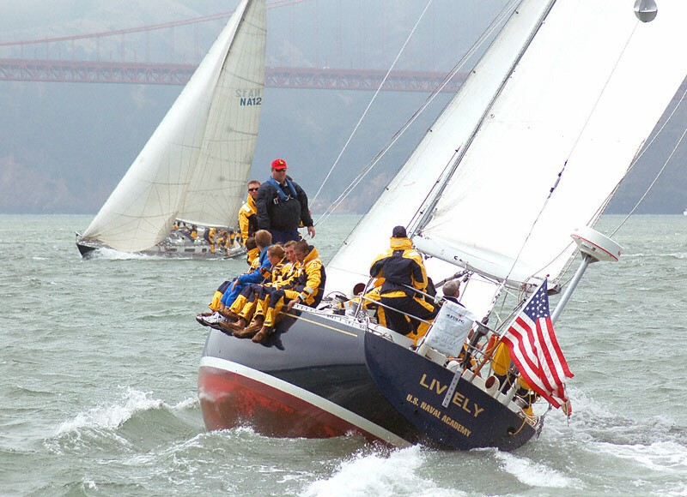
HOW SKSD AQUIRED THE LIVELY

Slide 6
HOW DID SKSD AQUIRE THE LIVELY
Sequence of events and dates leading to the decision of SKSD’s purchase of the 44 foot sailing yacht THE LIVELY.
September 16, 2015
SKSD Board Meeting Minutes reflect: A 'share' from Capt. Schapler informing SKSD Board that the 44' Lively was available for purchase from U.S. Naval Academy. Capt. Schapler proposes starting a SKSD sailing training program. The goal is to provide an additional extracurricular activity for students aged 14-18 years of age and to offer the students the opportunity to qualify as skipper.
The program would also teach the Washington State Boater Safety Course. Capt. Schapler is looking at the condition of the boat, cost of procurement, maintenance, insurance coverage, and moorage options. School Board Directors Chris Lemke, Greg Wall, Rebecca Diehl, Keith Garton, Patty Henderson were all present for this presentation.

Slide 7
Purchase Proposal Brought
Before The Board
September 16, 2015
SKSD Board Meeting Minutes introducing proposal to purchase the Lively at a 'greatly' reduced price.
https://drive.google.com/file/d/1VtlOkLZ0GuLDKYTyhnvbH6Gmo_Yz8CFJ/view
?usp=sharing
June 16, 2016
Skipper Schapley pens letter to The Robert Reverrman Foundation Grant Manager promoting and explaining the immediate future plans for the 44' Racing Sloop The Lively.
•Explanation and Promotion of The Lively to the grant manager for Robert Reverman Foundation..
https://drive.google.com/file/d/1lwcnhqO5LqavHChSq7rrxRfRWSuN5M9l/vi ew?usp=sharing

Slide 8
July 20, 2016
SKSD Board Meeting Minutes reflect that Kitsap County United Way presented a check in the amount of $16,624.59 to NJROTC Captain Todd Schapler, Harold Vickers and CTE Director Sara Hatfield. The funds came from South Kitsap NJROTC program at the June 15, 2016 Golf Classic hosted by United Way and attended by NJROTC students. School Board Directors Chris Lemke, Greg Wall, Rebecca Diehl, Keith Garton, Patty Henderson were all present for this meeting.
SKSD Board Meeting Minutes 7-20-16.
https://drive.google.com/file/d/1NNyWhQUE5deynKS4bL-3UZ-iFz4UyDxj/view?usp=sharing

Slide 9
November 18, 2016
South Kitsap Public Education Foundation presents $20,000 Robert Reverman Foundation Grant check to the Navy Junior Reserve Training Program. Funds
only to be allocated to the SKSD CTE/ROTC boat program. $8,000 of the grant was used to purchase the 44' Lively. The conditions of the grant usage specify grant money is only to be used for education and training. The registered owner of The Lively is South Kitsap School District. PDF Exhibit (3) Letter from South Kitsap Public Education Foundation presenting The Robert Reverman Foundation Grant for $20,000 payable to the South Kitsap School District ("Funds") representing the grant that SKPEF received from the Robert Reverman Foundation. The funds are restricted to the sole use and application for the Navy Junior Reserve Office - Sailing Program, which is administered by the South Kitsap High School CTE/ROTC boat program. The Reverrman Foundation requests a written report from the CTE/ROTC boat program every six (6) months, which sets forth the use of the Funds, progress and status of the boat.
South Kitsap Public Education Foundation Letter to South Kitsap School District presentation of $20,000 Robert Reverman Grant check to South Kitsap High School ("Funds").
https://drive.google.com/file/d/1J-UsnI6rinB-2KJf9JmpWMtb0JwDNTU/view?usp=sharing

Slide 10
March 7, 2018
South Kitsap School District Notice posted on SKSD Website that SKSD NJROTC Students Training on 44-foot sailboat.
SKSD Website posting of students training of Lively.
https://drive.google.com/file/d/1ffZaPfJKTfLsA12dYa2E3FX5fCquxOHz/view?usp=sharing
April 30, 2020
A grant from Washington State Department of Commerce of $24,000 (with legislative assistance from Rep. Jessie Young) was awarded to the South Kitsap Public Education Foundation who then donated the entire grant to South Kitsap School District to be used to replace major navigation instrumentation and effect 'other' repairs. (PDF Exhibit (4) $25,000 State of Washington Department of Commerce Grant for replacement navigation instruments and other repairs. The Department of Commerce sent a letter to Capt. Schapler. notifying him that Governor Inslee signed 2020 Supplemental State Capital Budget, which included an appropriation of $24,000 for the South Kitsap High School NJROTC Equipment (Port Orchard) Project.

Slide 11
It is notable at this point that one of the conditions of the grant is that any property relevant to the project (that would mean the Lively) must be owned or secured by a long-term lease that remains in effect for a minimum of ten years following the final payment date. So, South Kitsap School District must retain ownership of the Lively for ten years starting from the date that the last of the grant award is used. The grant ended on June 3, 2021. Certainly all the grant
money was expended on all new navigation and electronic replacements/upgrades for the Lively. Looks like the District is stuck with keeping the Lively till at least June of 2031.
Washington State Department of Commerce Letter to Capt.
Schapler.
https://drive.google.com/file/d/1u59yZv3jRBsxjftklnA8qpCktFBG69G0/view?usp=sharing

Slide 12
What Was the Original Cost of The Lively?
The Lively was purchased for $8,000 in 2016 using monies from the first grant of $20,000 awarded by the Robert Reverman Foundation. This left $12,000 of the original grant, and those funds are only to be used for education and training. Per the grant conditions, South Kitsap High School is not permitted to use the remaining funds for moorage fees, boat repairs, boat maintenance, etc. Another grant since the Reverman grant of $24,000 was awarded by the Washington State Department of Commerce. The term of this grant runs from 04-20-2020 through 06-30-21. It appears most if not all of this last grant was expended for the complete replacement of all navigation and other electronics on the Lively

Slide 13
What is the Current Value & Use of the Lively?
In the nine years that has passed since SKSD JROTC Program was awarded the $20,000, Reverman grant, it is difficult to imagine that the remaining $12,000 of that grant has been expended on. Certainly, what remains is sufficient to at least start what was 'promised' to be an encompassing education and training program for all 14-18 year old students attending the South Kitsap School District.
The Lively has been appraised with a value of $35,000 for purposes of insuring for hazards. The 2021 vessel license and registration are current. The registration reflects South Kitsap School District as the only owner of the Lively yet only the NJROTC Cadets attending SKSD are permitted to train on it.
Lively Registration and License Sales Tax Value in 2021 was $35,000.
https://drive.google.com/file/d/13S2UX1B9sNC9hjZrqxAyH_s8-8PAgTOg/view?usp=sharing

Slide 14
Here is "Who is who" on the South Kitsap Public Education Foundation. They have been very generous in soliciting private donations and pushing through public and private grant funds. The last grant they helped with has now obligated South Kitsap School District to retain ownership of the 44' Lively until
2031.
List of Board Members of South Kitsap Public Education Foundation
https://drive.google.com/file/d/1BLHZHDYQR0Kqsu92yFZe-bKljyu9NIH7/view?usp=sharing
The Lively continues to be little more than your classic hole in the water. This is certainly the case for the 14 – 18 year old population of the 9,935 students attending South Kitsap Schools. There are 9,975 students in SKSD only .4 percent are allowed to ride the Lively.

Slide 15
Absent other "free" grant funds in the near future, the continuing costs of operations, repairs, and maintenance and the requirement that South Kitsap School District now keep the Lively until 2031 raises the obvious question. In order to keep the Lively without further grants the cost to moor, repair, maintain, and operate the Lively will be falling squarely on the shoulders of South Kitsap School District taxpayers.
•
As we know, even the smallest boats are often not so fondly referred to as "that hole in the water" due to costs of operation, repairs and maintenance. Of course, a specialized 44' foot-racing sloop would be consider by most to be "a huge hole in the water" eating funds on a regular basis; fuels costs, repair costs, new sails, engine work or replacement, etc. The increase in expenses is directly proportional to the size of the vessel and frequency of use of course.

Slide 16
Will Our Community Obligate to Take Over Moorage, Maintenance & Repair Costs of the Lively?
Citizens Supporting South Kitsap School District believes that our community would likely support taking over the full annual costs to keep the Lively. Those costs now average between $10,000 and $12,000 annually. It is clear that the number of students who are enrolled in SKSD NJROTC is continuing to drop. One reason is the establishment of a new NJROTC 'Unit' closer to Gig Harbor and the others parts of the Peninsula that will continue to draw more and more new cadets to the program away from SKSD. Another problem is the decline of volunteers and boosters to work on and contribute toward operations and maintenance. As an example, it is $200 (normally over
$400) a month to tie the boat up at the Port Orchard Marina. Unfortunately, during the course of the COVID-19 outbreak the Lively has remained tied to the dock.

Slide 17
(Aged 14-18 year olds) Have a chance to sail on the Lively?
When will the rest of our South Kitsap Students
The June 16, 2016 letter penned by Captain Scahpler was very clear that all students attending south kitsap schools would be "eventually" integrated into the school's sailing and nautical training program. It is nearly eight years now since the school district bought the Lively and they have yet to integrate any students into this unique sailing and seamanship program. One thing for sure, if the District continues to pay the expenses to retain the vessel with taxpayer dollars then they must honor the commitment they made back in 2016 to offer the opportunity to all 14 - 18 year old students attending south Kitsap schools. Having only 30 or 40 SKSD students that are enrolled in NJROTC is not a fair or equitable use of this exclusively for 40 students (only cadets as of the re-posing of this page) and equates to a mere .4 percent of the total student population of all of SKSD schools, If NJROTC really wants it, then NJROTC headquarters as well as the booster club should take over the full- funding. This is only right since after 9 years it is still only SKSD NJROTC Cadets being permitted to learn to sail the boat. At the end of the day the simple question remains, why should other taxpayers foot the bill for a program that benefits so few?

Slide 18
Registration, Taxes, Ownership, Costs, & Bills
Purchase - Ownership - License - Registration - Maintenance Costs 44' Lively
https://drive.google.com/file/d/1sR3nVOSQ2BeajBuJ1u0G7M81dpO9NcYn/view?usp=sharing
Lively Port Orchard Marina Moorage Contract and Costs
https://drive.google.com/file/d/1x14GxJQLCPKSaXOzmX3PYnciTc2twm0b/view?usp=sharing
Washington State Sales Tax Paid on 44' Lively Purchase on 04-04-16
https://drive.google.com/file/d/1DvtAixotpI78lviePcQbUqbgGaAC5MKl/view?usp=sharing
Washington State Sales Tax $2,788.73 for 44' Lively Value of $35,250
https://drive.google.com/file/d/10tR3x1usmB-yAB1IMQbhEdOIZOR_0gAH/view?usp=sharing
2016-2018 Estimated Costs for 44' Lively
https://drive.google.com/file/d/1GsHZ364ufZBvfzTAO4hZ m8eSamN8zW/view?usp=sharing
2016 -2021 Billings Paid for 44' Lively
https://drive.google.com/file/d/1nDX7yv4OdNJWEbJUvKCg7FMjEDXbxa96/view?usp=sharing

Slide 19
Ads for 44' Mark II Navy Training Sloops
Find Resale Value of Sloop Here: http://tinyurl.com/3d7j8c8h
44' Lively Came From Fleet of 25 44' Mark II Racing Sloops
https://drive.google.com/file/d/1lPDKnqXYoWj7K0vf9ifyc-qMVWvTM-fW/view?usp=sharing
June 2013 Internet Posting One of Three 44' Mark II Boats for Sale
https://drive.google.com/file/d/1HIWZD5ex6vGsLOfMDrDjPjN9UenEo0Bu/view?usp=sharing
Navy Mark II 44' Racing Sloop Sale Cancelled What Comes In the Box..
https://drive.google.com/file/d/1NGE6Zyo34VWlLZEsv4uy1wVi5m1jTyJ0/view?usp=sharing

Slide 20
Various Exterior & Interior Views 44' Mark II Naval Academy Sloops
44' Mark II Boat Keel View
https://drive.google.com/file/d/1EdcaLBU-ToEY5lMs4kYvAilFocj-EFEB/view?usp=sharing
44' Mark II Boat Screw View
https://drive.google.com/file/d/1wac1SxP9P-vuYj3z-Z4w3DAGz5l-oBBy/view?usp=sharing
44' Mark II Racing Sloop Hull Being Laid Up
https://drive.google.com/file/d/1-6tHLLfqnxWxO-WYDt6HvZF4Kj9M-qoc/view?usp=sharing
44' Mark II Boat Racing Sloop Compass and Cockpit
https://drive.google.com/file/d/13cR9IUnXq4KX5Js8VfXCNM1-T571TfpR/view?usp=sharing
44' Mark II Boat Racing Sloop Birthing and Galley Views
https://drive.google.com/file/d/1-SDvM1Cy8tsosB3kJIT_wLGLqCZ8IbQk/view?usp=sharing

Slide 21
44' Mark II Boat Racing Sloop Galley Views
https://drive.google.com/file/d/1gxP2aN865Nq-I53WRsvRGLWTT6ezRTVz/view?usp=sharing
44' Mark II Boat Racing Sloop Head View
https://drive.google.com/file/d/1kkBCc-dOA05y1q3Gg9Ql4BUBz3N9WmSj/view?usp=sharing
44' Mark II Boat Racing Sloop Yammar Engine Access Hatch
https://drive.google.com/file/d/1J8lMpeaA5zBvcpeVrjbPufQwiB0B1sF0/view?usp=sharing
44' Mark II Boat Racing Sloop Yammar Engine View
https://drive.google.com/file/d/1VfhUnzEX7q9K27NgE5IgSyCDuIoAPwVP/view?usp=sharing
44' Mark II Boat Racing Sloop Sail Profile Drawing
https://drive.google.com/file/d/1E1VenHkDMFuU8_Z4G3wtXLEeavEOGF3l/view?usp=sharing

Slide 22
44' Mark II Boat Racing Sloop The Lively and Golden Gate Bridge
https://drive.google.com/file/d/1vRzcxmvZAFE9SqPKHpRiNSRTfQBCCG5k/view?usp=sharing
44' Mark II Boat Racing Sloop Topside Drawing
https://drive.google.com/file/d/1TyIRXJEE2cGPJpd2lFxGWcCd7e-Uk2nf/view?usp=sharing
44' Mark II Boat Racing Sloop Topside Drawing
https://drive.google.com/file/d/1GqY40ZVqbdK1-nVrQCGGVrnQhXk6mzuo/view?usp=sharing

Slide 23

A Short History of the Original 44' Sloop Lively (1821-1824) (1821 - 1825) History of the First Sloop Lively Transiting to Texas
https://drive.google.com/file/d/1gAH2hQbjjPHEYJztQHlLcMdV_hLa5vHm/view?usp=sharing
The First Sloop Named Lively Sails to Texas with 20 Men Onboard 11-23-1821
https://drive.google.com/file/d/1ul9kYa_1u5n5wjCMFAfxqV5bReB66I8d/view?usp=sharing
NJROTC Hold Harmless Agreement for sailing on the Lively
https://drive.google.com/file/d/1qyHRajFWx1fStL9APWUVAt7IkwRjSvRz/view?usp=sharing

Slide 24
Various Exterior & Interior Views 44' Mark II Naval Academy Sloops
44' Mark II Boat Keel View
https://drive.google.com/file/d/1EdcaLBU-ToEY5lMs4kYvAilFocj-EFEB/view?usp=sharing
44' Mark II Boat Screw View
https://drive.google.com/file/d/1wac1SxP9P-vuYj3z-Z4w3DAGz5l-oBBy/view?usp=sharing
44' Mark II Racing Sloop Hull Being Laid Up
https://drive.google.com/file/d/1-6tHLLfqnxWxO-WYDt6HvZF4Kj9M-qoc/view?usp=sharing
44' Mark II Boat Racing Sloop Compass and Cockpit
https://drive.google.com/file/d/13cR9IUnXq4KX5Js8VfXCNM1-T571TfpR/view?usp=sharing
44' Mark II Boat Racing Sloop Birthing and Galley Views
https://drive.google.com/file/d/1-SDvM1Cy8tsosB3kJIT_wLGLqCZ8IbQk/view?usp=sharing

Slide 25
SKSD SCORES “FREE MONEY”
Washington State Department of Commerce “Awarded” SKSD A $24,000 Grant
(But there were strings attached)
A few years ago the District applied for a grant from Washington State Dept. of Commerce. The grant awarded (free money) was about $24,000. It was to be for navigation equipment replacement and repairs. A condition of the grant is that the District must keep the sailboard another 10- years, “unless” - they sell it and then convert the cash into a new use that is similar to what the grant was intended for to begin such as what it was prior to 2015.
What follows here are further details and the timeline of how the Lively came into ownership of the South Kitsap School District.
SKSD is Currently the Owner of
“THE BIGGEST SAILBOAT”
of Any Public School District in Our Nation!

Slide 26

A Short Movie “The Lively”
(How the few privileged are enjoying it)
SKSD 44' Sloop The Lively.mp4
Double Click to Play
Lively Embedded Video:
https://youtu.be/9fUlgoo1O34

Slide 27
SKSD MUST PRACTICE INCLUSION & PROMOTE EQUITY BY ACCOMODATING ALL SKSD STUDENTS
•
SO THEY ALL MAY LEARN TO SAIL!
One answer could be to form a sailing club
(Note: SKSD Already Established A Rowing Team)
A small fleet of sailing dinghies could be purchased in order to form an all inclusive SKSD sailing club serving all SKSD students from ages 14-18.
The Washington State Department of Commerce who awarded the $24,000 grant stipulated this use must be in force for at least 15-years from the date of the grant being awarded to the district. Here is the response from their Director of Commerce when I asked if the Lively could be sold, then those proceeds used to purchase a small fleet of sailing dinghies. Here was their response when asked About this possible swap.

Slide 28
Washington State Department of Commerce Reply to My Inquiry Regarding Lively Grant Changes
From: Sample, Kari (COM) [kari.sample@commerce.wa.gov Sent: Tuesday, August 10, 2021 1:52 PM
To: jndkimble@wavecable.com
Cc: daily@skschools.org; 'Winter, Tim'
Subject: RE: S21104 S Kitsap HS NJROTC Equipment - Inquiry
As long as the original legislative intent is following what was set forth the grantee would be able to discuss making the changes.
Kari Sample| PROGRAM MANAGER Community Capital Facilities | Washington State Department of Commerce1011 Plum StreetPO Box 42525 Olympia,
WA 98504
Cell: 360-764-3090Email: kari.sample@commerce.wa.govProgram
Email communications with state employees are public records and may be subject to disclosure, pursuant to Ch. 42.56 RCW.

Slide 29
My Inquiry To Washington State Department of Commerce
Regarding Lively Grant Changes
From: Dave Kimble <jndkimble@wavecable.com> Sent: Monday, August 9, 2021 9:06 PM
To: Sample, Kari (COM) <kari.sample@commerce.wa.gov>
Cc: daily@skschools.org; 'Winter, Tim' <winter@skschools.org> Subject: RE: S21104 S Kitsap HS NJROTC Equipment - Inquiry
Good first step, Kari. Thank you so much for getting back. Your reply does seem a bit ambiguous but I think the point to be take is that I am not an employee, and not an elected, merely a local community member. The goal was to get the ball moving as I to think the student population would be better served with a real sailing club for all the students. NJROTC folks can still be involved.
So I have to ask, would this be in the scope of the project to purchase many smaller craft and actually institute the sailing club as was promised? That is what I would like to know. Given that I am just a local citizen it seems to me that I should put in you contact with an elected who can better discuss this issue as a member of the school board. If that is ok, I can ask Director Daily to make contact with you. would that help? The superintendent is an employee, that is who myself and the director have been discussing this issue of the sailboat and it's uses. Director Jeff Daily is copied on this reply to you so you will have his email. I believe he is on leave until at least the end of the week. I will also copy Superintendent Tim Winter
Sincerely, David

Slide 30
Washington State Department of Commerce Reply to My Inquiry Regarding Lively Grant Changes
From: Sample, Kari (COM) [mailto:kari.sample@commerce.wa.gov] Sent: Monday, August 09, 2021 8:51 PM
To: jndkimble@wavecable.comS
Subject: RE: S21104 S Kitsap HS NJROTC Equipment - Inquiry Mr. Kimble,
Thank you for your patience and waiting for me to respond. Under state grant contracts, a sale of assets improved with grant funds are generally only allowed if the grantee’s use of sale proceeds facilitates the original’s project’s purpose as it is described in the Scope of Work and in the legislative appropriation; and the decision whether to sell the asset approved with grant funds and replace it is a decision to be made by the Grantee. Commerce has not been approached by the Grantee to discuss possible/ \alternative plans; and that if the Grantee does initiate communications with Commerce regarding a potential alternative plan, Commerce would be happy to work with the grantee to discuss its alternative options and whether any
proposed plan would be feasible in light of the grantee’s obligations under the grant contract.
Kari Sample| PROGRAM MANAGER Community Capital Facilities Washington State Department of Commerce

Slide 31
My Inquiry To Washington State Department of Commerce
Regarding Lively Grant Changes
From: Dave Kimble jndkimble@wavecable.com Sent: Monday, August 2, 2021 5:00 PM
To: Sample, Kari (COM) <kari.sample@commerce.wa.gov> Subject: RE: S21104 S Kitsap HS NJROTC Equipment - Inquiry
Why thank you Kari!
Hope to hear from you soon. This is all about options. This is the view of the Superintendent as well. So I am the scout at this point, so to speak. And I will share with Director Daily who was made aware of this asset.
Sincerely, David

Slide 32
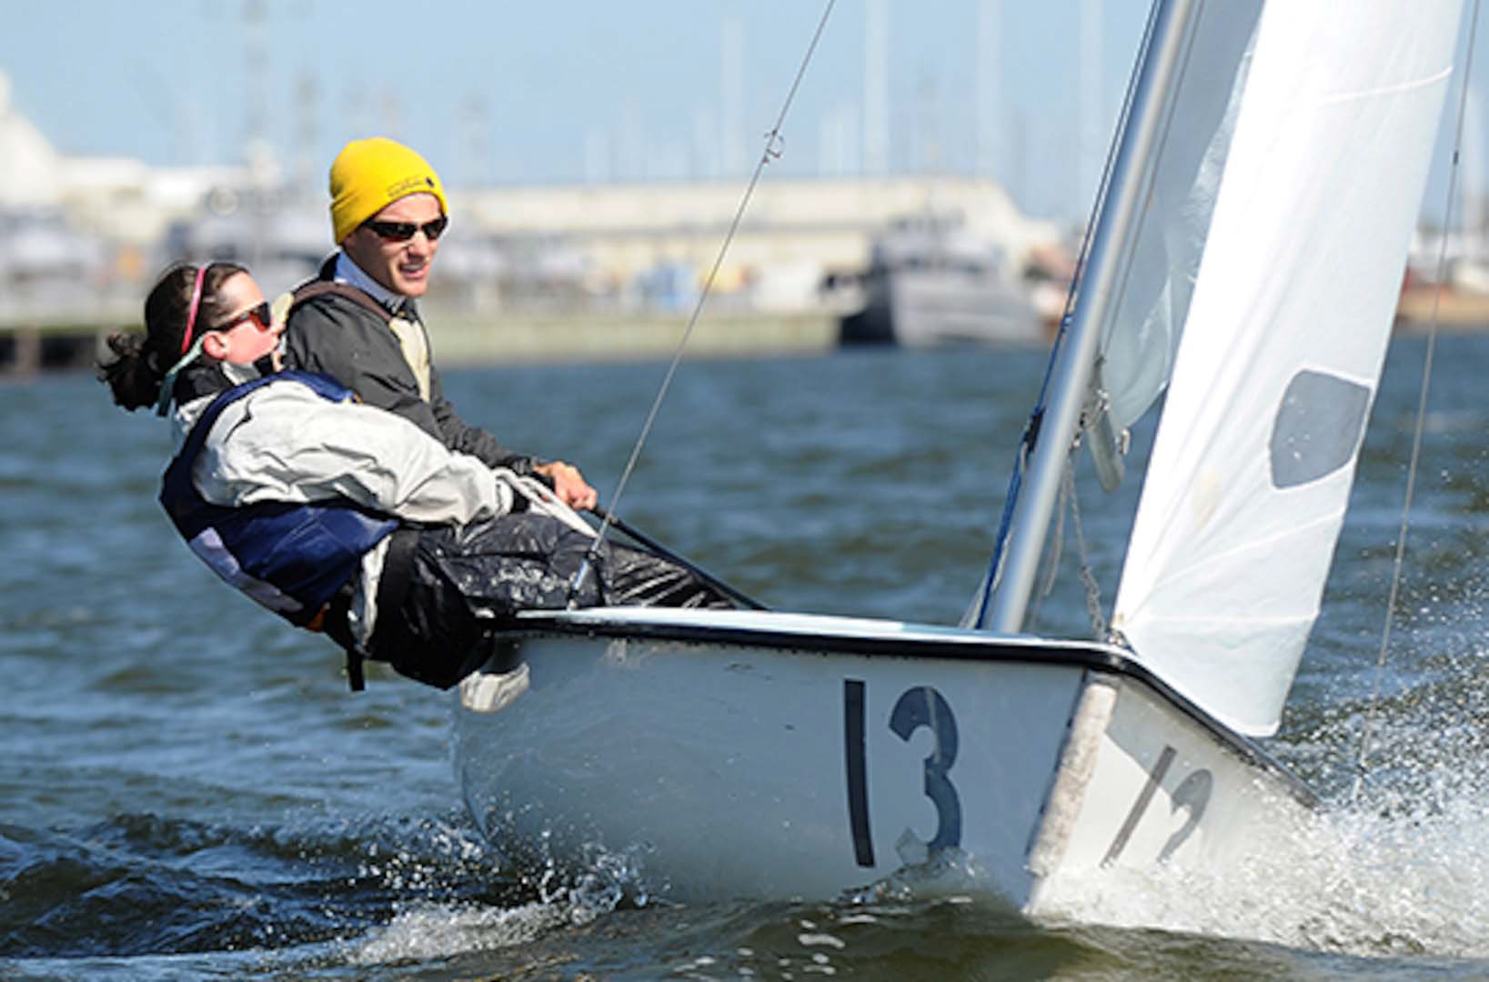
Here Is Where SKSD Can Acquire Small Two-Person Sailing Dinghies
At Discounted Costs
DLA coordinates Naval Academy donation of sailing dinghy fleet

Slide 33
Note: The Lively was firt bought at auction from the Naval Academy
by the University of Washington who later sold it to SKSD.
Members of the U.S. Naval Academy's varsity offshore sailing team steer a Club FJ sailboat in Maryland's Severn River. DLA recently helped the academy donate 21 of the small watercraft to the SUNY Maritime Academy in New York City. By Jake Joy / Published Aug. 4, 2015 Annapolis, Maryland, Baggywrinkle? Futtock? Cat-head? Scuttlebutt?
These are not exasperated guesses at Rumpelstiltskin’s name. They are nautical terms; part of a bizarre cornucopia of “olde tyme” sailing words. On a planet with a surface that is 70 percent water, with 80 percent of its commerce travelling on that water, someone needs the skills to conquer both waves and obscure maritime terms to keep the world economy in good order.
The U.S. Naval Academy, founded in 1845 along the Chesapeake Bay in Annapolis, Maryland, teaches its students to turn chaos into order upon the waters. It has maintained a robust student offshore sailing program for more than a 150 years to help with that mission. Nautical-minded midshipmen at the institution race their sporting peers from around the country during varsity- level intercollegiate sailing events staged throughout the Atlantic. Sailboat racing combines teamwork, decisive leadership and attention to detail into one intense wind and wave driven package.

Slide 34
DLA Disposition Services staff members at Fort Meade, Maryland, recently coordinated the donation of a 21-boat fleet of two-person sailing dinghies previously used by the team for academy-hosted regattas on the Severn River. The dinghies –called Club FJs of Flying Juniors – are worth more than $5,000 apiece and were put through their paces for seven summers by the Naval Academy’s varsity offshore sailing team, beginning in 2005. According to academy sailing officials, the school replaced its fleet with a new set of Club FJs in October 2012, rendering the boats excess.
The recipient of the fleet lies 232 miles to the northeast – as the crow flies, not as the dinghy sails – at the State University of New York Maritime College, which has a mandate to supply the United States with sea-ready sailors. Its student body earns nautical-related degrees and travels the world each summer aboard the 565-foot Training Ship Empire State IV.
The New York City-based SUNY Maritime also got its start shortly after the Civil War, which crippled the nation’s shipping industry. There’s a historical precedent for the donation of the current fleet of Club FJs. SUNY Maritime – the first of its kind in the country – began as a water-based institution, existing entirely upon the USS St. Mary’s, a donated Navy vessel set up as a grammar school that would cruise with the students in the summer. In 1907, the school moved to the also-donated Navy gunboat USS Newport, which would move in and out of active Navy service in the following decades.

Slide 35
NOT QUITE YET THE END OF THE LIVELEY STORY!

